Slide 1


PROVISO TOWNSHIP HIGH SCHOOL
DISTRICT 209
Open Enrollment Updates
Plan Year 9/1/2023-8/31/2024

Slide 2

BROKER CONTACT INFORMATION
VistaNational has the following staff dedicated to assist you:
  Patricia Allen, Account Manager; assists in general benefit inquiries and member ID cards.
  Tel # (630)468-6544 or email at allenp@vistanational.com
  Katie Mulcahy, Claims Manager; assists in reviewing your Provider’s explanation of benefits and works directly with the provider to determine if the amount due by you is accurate.
  Tel #(630)468-6509 or email at mulcahyk@vistanational.com
  Carol Sather, Wellness Co-Ordinator
  Tel #(630)468-6511 or email at satherc@vistanational.com

Slide 3


Slide 4
OPEN ENROLLMENT OVERVIEW
(per your email on 8/8/2023)
Open Enrollment for Eligible Employees
This is your annual election period to review your employee benefits, enroll or terminate yourself and/or dependents, review & select your plans. Outside of open enrollment you will need a qualifying event to make a change to your enrollment. See HR and notify the Benefits Specialist within 30 days of the date of event
Open Enrollment is in NOW! You must confirm your elections no later than Noon on Friday, August 25, 2023.

Slide 5
OPEN ENROLLMENT OVERVIEW
(per your email on 8/8/2023)
The email you received on 8/8/2023 included your Benefit Summary information and forms. Materials can also be found on the District’s Intranet.
Before Noon on Friday, 8/25/23, you will complete & return to Arlene Sabado:
1. Your Coverage Election Agreement (all eligible employees)
2. Waiver form, if not electing medical coverage for the period of 9/1/23-8/31/24
3. Medical Enrollment forms are required by everyone!
4. Dental/Vision changes will require a form
5. Voluntary Life- will hold their open enrollment in September, watch email for more information after Labor Day

Slide 6






REVIEW OF BENEFITS
9/1/2023-8/31/2024

Slide 7

BENEFITS 9/1/2023-8/31/2024
MEDICAL: changes in the plan designs, YOU MUST SELECT A PLAN TO HAVE COVERAGE.
  There are no changes to the premium contributions
DENTAL: No plan changes; 2% increase to contributions
VISION: No plan or contribution changes
REMEMBER, YOUR FORMS MUST BE SUBMITTED TO ARLENE SABADO BY NOON ON FRIDAY, 8/25/23.

Slide 8
BENEFITS 9/1/2023-8/31/2024
BASIC LIFE, VOLUNTARY LIFE & LTD are transferring to The Standard from Lincoln Financial
The rates you pay today remain the same UNLESS you have aged up to the next age bracket or change your policy amount
WE WILL HOLD A SEPARATE OPEN ENROLLMENT IN SEPTEMBER FOR THE VOLUNTARY LIFE BENEFIT. PLEASE WATCH YOUR EMAIL FOR UPDATES.

Slide 9


BCBS MEMBER OVERVIEW

Slide 10
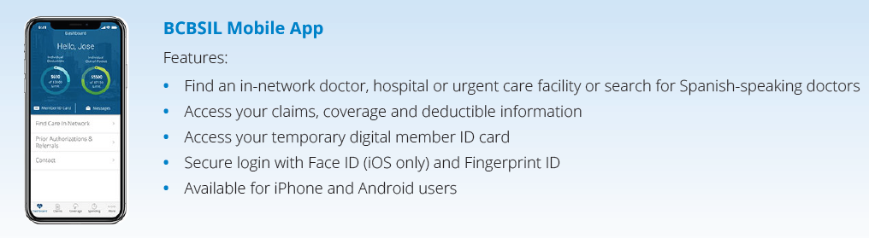
BLUE ACCESS FOR MEMBERS
(BAM)
Using your BCBSIL ID card, be sure to register for the member portal at www.bcbsil.com
Navigate thru the site for member resources, provider network, cost estimator tools, view your benefits & explanation of benefits.
Available programs are also found on the BCBSIL site or download the Mobile App
All participation in programs is CONFIDENTIAL

Slide 11
BCBSIL ID CARDS
You will receive a new ID card if you are on or select the PPO (Blue Choice Options or HSA HDHP) or HMO plans. These will be mailed to your home address (be sure it is updated). They will arrive in a plain white envelope.
Notify all providers, including your retail pharmacy, that you have a new plan& group number effective 9/1/2023.

Slide 12
NETWORK DEDUCTIBLE &
OUT-OF-POCKET AMOUNTS
If you already received services between January 1-August 31, 2023, the amounts applied to your deductible & out-of-pocket will be carried forward to the plan you select for 9/1/2023.
You will NOT begin with a new deductible
You will need to satisfy the difference of the new deductible before eligible services will be paid by BCBSIL
All deductibles & out-of-pocket thresholds reset January 1 of each year

Slide 13
PRESCRIPTION DRUG
The National Prescription Drug List is updated by the government quarterly.
BCBSIL Performance Drug List applies to BCO/HMO members and the Integrated Drug Card applies to HSA PPO plan members.
Any changes you experience in your prescription drug coverage or costs are based on these changes, not PTHS.
Use of a “Preferred” in-network retail pharmacy is recommended for the higher discount & lower cost out of pocket. Other retail locations may be used, but you will incur a higher cost
Mail order is available on the PPO & HMO plans, receiving a 90-day supply at your home, compared to a 30-day supply at a retail pharmacy

Slide 14
PRESCRIPTION DRUG
Other savings options:
  GoodRx.com or Singlecare pricing may be presented to your retail pharmacy instead of using your BCBS card. This is outside your BCBS plan, but the savings can be significant
  Walmart’s Generic Drug list (over 500 medications) for those maintenance drug you take. Outside of your BCBS plan, you will pay $4 for a 30-day supply and $10 for a 90-day supply.
  Manufacturer coupons, mostly available for higher costing medications provide savings to you. Your provider or pharmacy may have these available to share with you.

Slide 15
REQUIRED FORMS
  COMPLETE YOUR APPROPRIATE FORMS BY NOON ON FRIDAY, 8/25/23 TO SECURE YOUR COVERAGE FOR THE PERIOD OF 9/1/2024-8/31/2025
  If you are enrolling in the HMO plan, you MUST complete Section 4 capturing your PCP & Medical IPA group for each person enrolling

Slide 16
BCBSIL MEMBER BENEFITS WITHIN YOUR PLAN

Slide 17
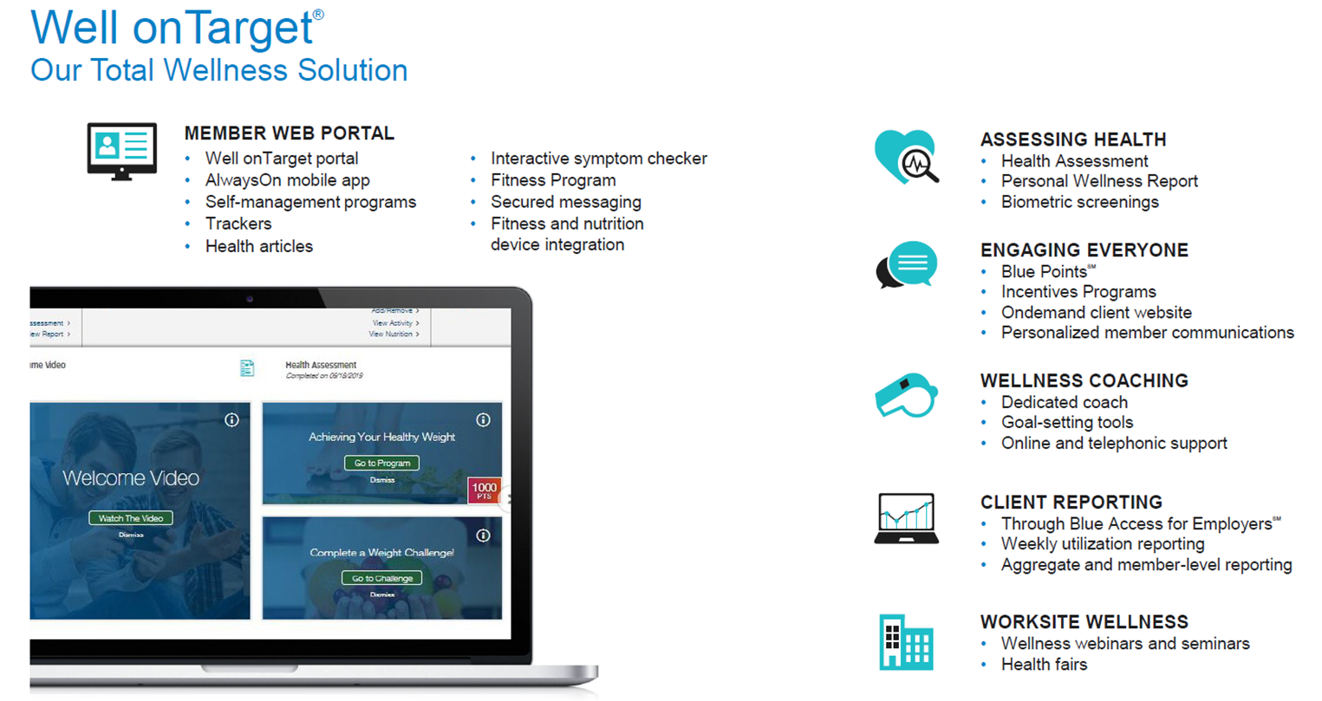

Slide 18
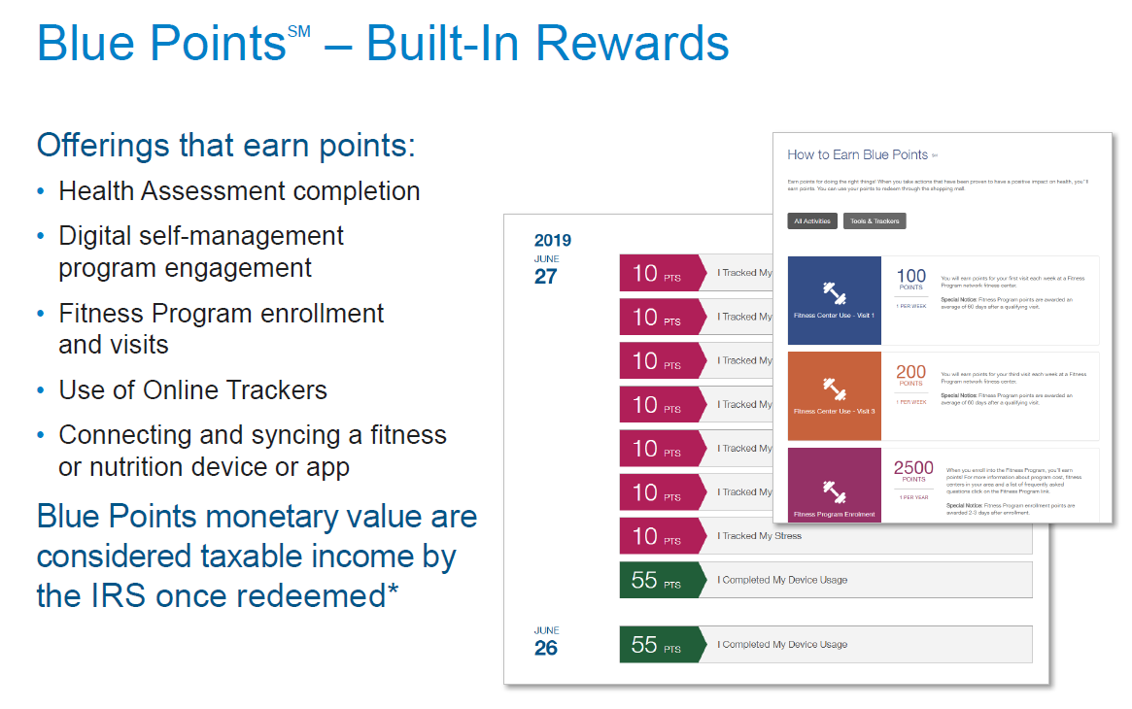

Slide 19
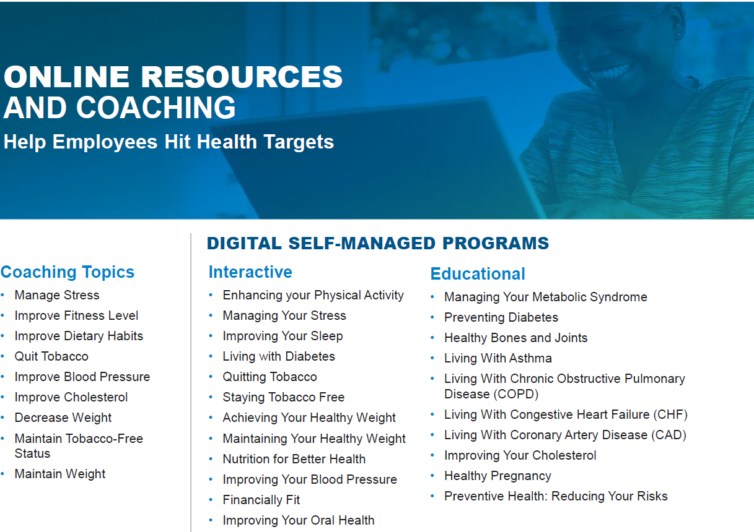

Slide 20
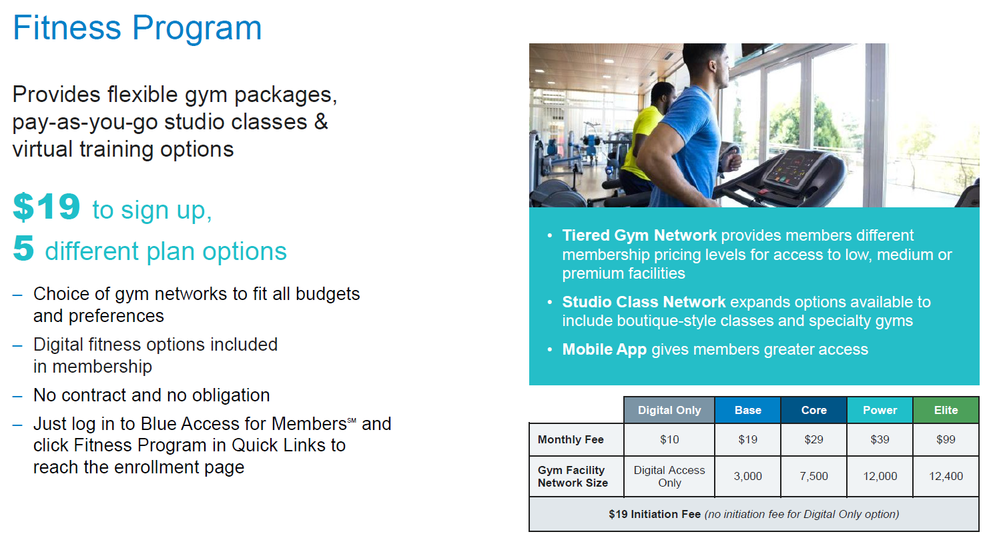

Slide 21
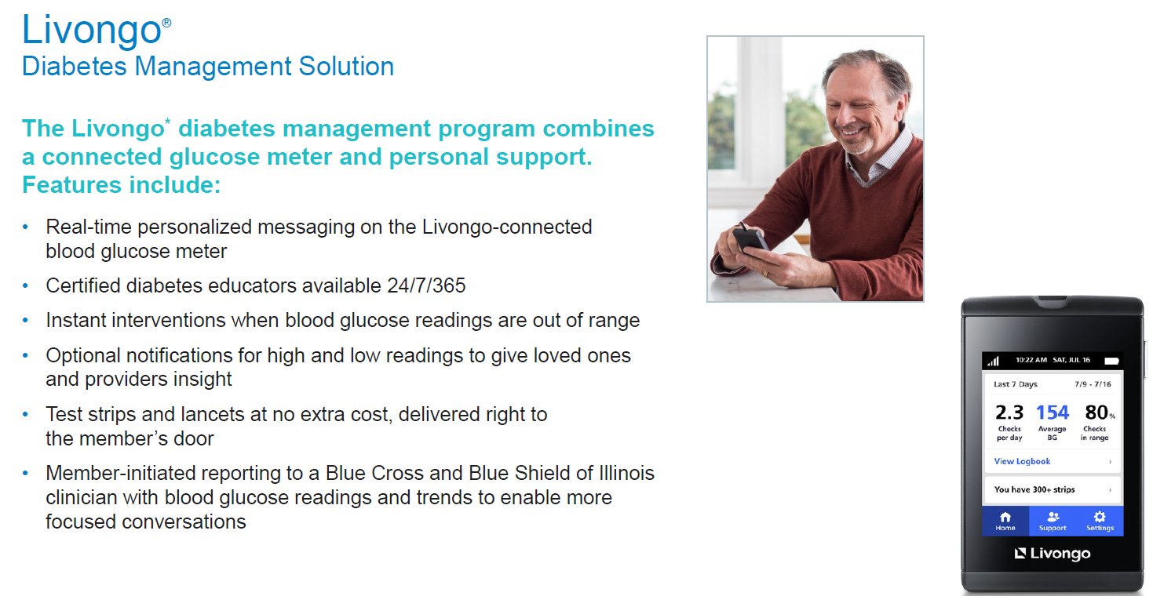

Slide 22
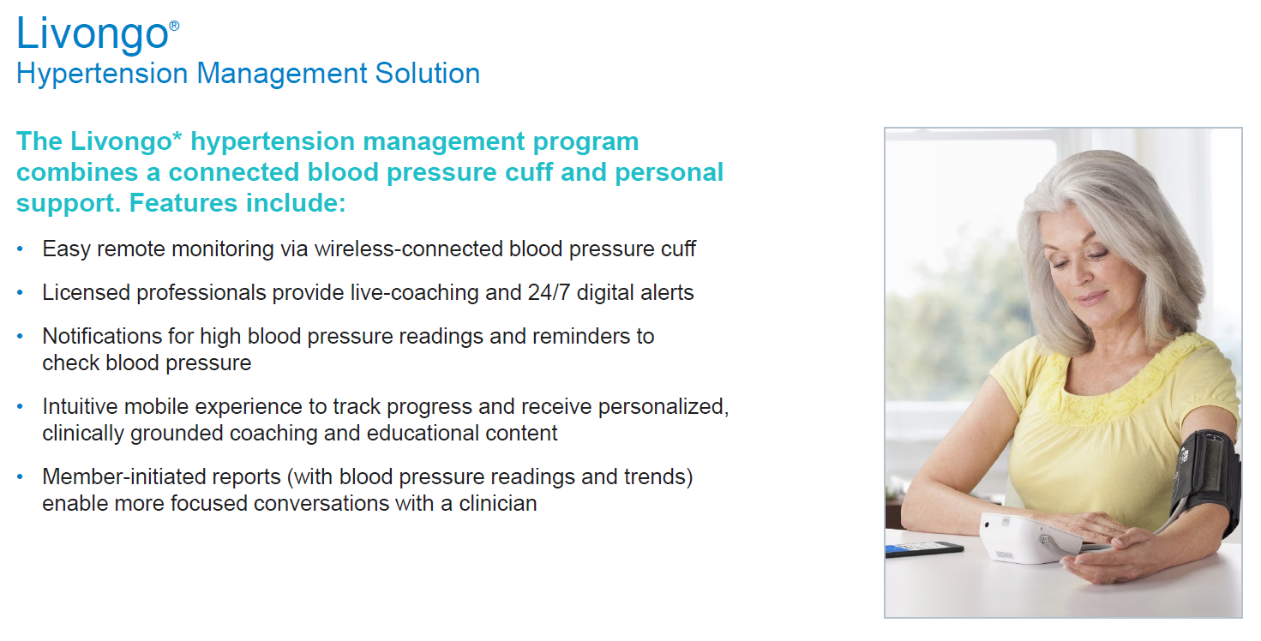

Slide 23
MEDICAL PLAN OPTIONS
9/1/23-8/31/24

Slide 24

BLUE CHOICE OPTIONS
PPO PLAN OPTION

Slide 25


PPO PLAN CHANGES
Your new PPO plan uses the Blue Choice Options network and is a dual network PPO plan.
You will have access to both the Choice Select & Large PPO network of providers. We found that nearly 90% of the providers being used by members today are in both networks. There will be minimal disruption to your provider selection
Locate your providers at www.bcbsil.com or thru your BAM portal (Blue Access for Members)
  Find Care to begin your search
  In this drop down menu,
  select Blue Choice Options [BCO]
  Providers in Tier 1 will have the better benefit applied
  Providers in Tier 2 will have a lower benefit applied

Slide 26
HOW DOES THE PPO PLAN WORK?
(Refer to SBC for Out-of-Network benefit)
SERVICE | IN-NETWORK TIER 1 (Blue Choice Select) | IN-NETWORK TIER 2 (Large PPO Network)
Deductible – Individual Deductible – Family | $1,000 $2,000 | $2,000 $4,000
Coinsurance (applies after deductible has been met) | 20% | 30%
Out-of-Pocket Max – Individual Out-of-Pocket Max – Family | $2,000 $4,000 | $3,000 $6,000
Emergency Room (per Occurrence, waived if admitted) | $200 Copay | $200 Copay
Prescription Drug (applies after deductible has been met) | 20% | 20%
All other services will apply to the plan deductible & applicable coinsurance based on whether your provider is Tier 1 or Tier 2.
Deductibles work together so you can jump between networks but will need to satisfy the difference until coinsurance applies.

Slide 27
EXAMPLE OF BCO BENEFIT
All satisfied deductibles & out-of-pocket dollars YTD will be applied to Tier 1
Obtain services after 9/1 with a Tier 1 provider, satisfy the difference from your $500 PPO plan to the $1,000 new plan deductible, eligible services will be paid at 80%, leaving you with 20% coinsurance
Obtain services after 9/1 with a Tier 2 provider, satisfy the difference from your $500 PPO plan to the $2,000 new plan deductible, eligible services will be paid at 70%, leaving you with 30% coinsurance
Bouncing between networks provides the flexibility for you to select your providers
You will never pay more than the annual out-of-pocket maximum

Slide 28
HDHP HSA
PPO PLAN OPTION
(High Deductible Health Plan
HSA Eligible)

Slide 29

HDHP HSA PPO PLAN
The HDHP HSA PPO plan continues to use the Large PPO network of providers
Through the BAM portal (Blue Access for Members)
  Find Care to begin your search
  In this drop down menu
  Select Participating Provider Organization [PPO]

Slide 30

HDHP HSA PPO
CONTRIBUTION INFO
As long as you are enrolled & eligible to contribute to an HSA (Health Savings Account), the District will offset your medical costs by contributing to your First American Bank account
  $125/month for Employees with Single Coverage (annual max $1,500)
  $250/month for Employee/Spouse & Employee/Child(ren) coverage (annual max $3,000)
  $333.33/month for Employee/Family coverage (annual max $4,000)
You are not eligible to contribute if you are eligible for or enrolled in Medicare (this includes the auto enrollment in Medicare Part A when you turn 65, Medicaid, or are enrolled in another health plan that is not a HDHP
If you are new to the plan, refer to your Human Resources Department for information on opening your account
You own the account! PTHS only needs the account number to deposit your funds into.
Use your dollars to medical, dental and/or vision eligible services for yourself or tax eligible dependents
Refer to www.irs.gov or your personal tax advisor for more information

Slide 31
HSA CONTRIBUTION UPDATES
(refer to your personal tax advisor with questions)
INDIVIDUAL CHANGE
FAMILY CHANGE
IRS HSA 2023 contribution threshold
  Contribution limits: $3,850*
  *if over age 55, you can contribute an additional $1,000 (catch-up)
  You must meet eligibility requirements to contribute to your HSA account
  Cannot be enrolled in another health plan that is not a High Deductible Health Plan
  Cannot be eligible for Medicare or Medicaid
IRS HSA 2023 contribution threshold
  Contribution limits: $7,750*
  *if over age 55, you can contribute an additional $1,000 (catch-up)
  You must meet eligibility requirements to contribute to your HSA account
  Cannot be enrolled in another health plan that is not a High Deductible Health Plan
  Cannot be eligible for Medicare or Medicaid
  If any of your dependents are affected by the above, you may need to contribute only the single amount

Slide 32
HDHP HSA PLAN DESIGN
(refer to SBC for Out-of-Network benefits)
SERVICE | IN-NETWORK
Deductible – Individual Deductible – Family | $3,000 $6,000
Coinsurance (applies after deductible has been met) | 0%
Out-of-Pocket – Individual Out-of-Pocket – Family | $3,000 $6,000
Emergency Room (applies after deductible has been met) | 0%
Prescription Drug (applies after deductible has been met) | 0%

Slide 33
BLUE ADVANTAGE HMO PLAN OPTION

Slide 34

HMO PLAN OPTION
There is only 1 HMO plan available
Through the BAM portal (Blue Access for Members)
  Find Care to begin your search
  In this drop-down menu
  Select Blue Advantage HMO [ADV]
  ALL HMO PARTICIPANTS MUST SELECT A MEDICAL CARE GROUP (IPA) and a PCP (Primary Care Physician). Females may select a WPHCP within their Medical Care Group as their OB/Gyne.
  Locate the 3-digit IPA & 9-digit NPI number on the BCBS portal & list it on the enrollment application

Slide 35
HMO GENERAL INFO
The Blue Advantage HMO Medical plan is a Managed Care program, offering the lowest out-of-pocket costs of all District offered plans.
There are no out-of-network benefits in this $0 deductible plan
Copayments apply for all services
Referrals are required for all care outside of your PCP. See your PCP to obtain a referral to another provider, as needed.
You must follow the guidelines of the plan for your benefits to be covered

Slide 36
BAHMO PLAN DESIGN
(NO Out-of-Network benefits, refer to SBC)
SERVICE | IN-NETWORK
Deductible – Individual Deductible – Family | $ 0 $ 0
Copayments Referral required for Specialist Visit | PCP $30 Specialist $50 Urgent Care (affiliated with PCP) $30
Out-of-Pocket – Individual Out-of-Pocket – Family | $1,500 $3,000
Emergency Room (Per Occurrence, waived if admitted) | $100
Prescription Drug (applies after deductible has been met) | Tier 1- $7 Tier 2- $15 Tier 3- $40 Tier 4- $40

Slide 37


REVIEW OF
WELLNESS PROGRAM

Slide 38
WELLNESS SCREENING
There is a new structure to the program for 2023-2024
Employees must complete their biometric screenings either onsite, offsite at the participating lab or with their Primary Care Physician between 8/1 and 10/6/2023.
All forms must be submitted to the Bravo portal no later than 10/13/2023. No late submissions will be accepted.
WATCH YOUR EMAILS FOR MORE INFORMATION ON THE BRAVO WELLNESS BIOMETRIC SCREENING

Slide 39
REGISTRATION IS IMPORTANT!!
As long as you are enrolled in one of the PTHS District sponsored BCBSIL health plans, you are eligible to participate in the Bravo Wellness Program.
To get started after xxxdate pending from Roger visit the Bravo portal at my.bravowell.com/proviso or call directly to 1-844-925-2782
  If you are already registered from last year, you do not need to re-register.
You have an opportunity to earn up to $1,255 per year in free money, which is placed on a rewards debit card. Use your money for any purchase, anywhere you shop! It does not need to be related to healthcare costs.
  If you already have a debit card in your possession, DO NOT DISPOSE OF IT until it expires. Your card will be reloaded as you earn rewards money.
Program completion dates are outlined, refer to your Bravo email for more information.
Upcoming important dates for onsite health screening & flu shot inoculation will be announced. We are finalizing October dates at all 3 schools, so watch your emails for more information.

Slide 40
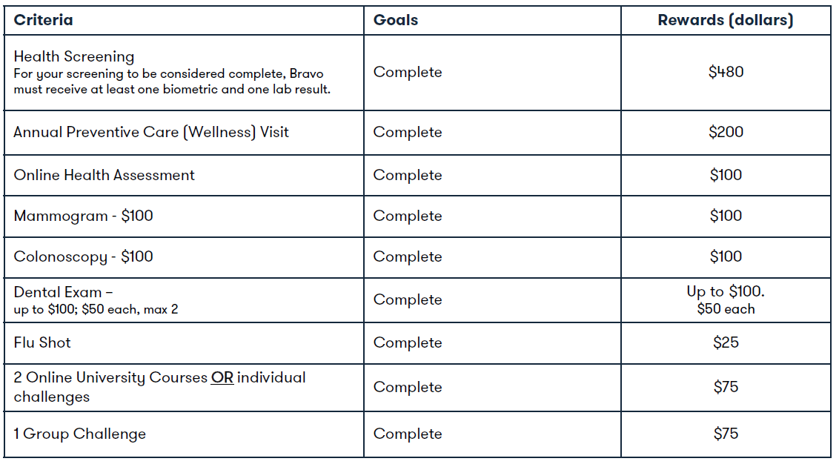

BRAVO WELLNESS
PROGRAM PLAN DESIGN (new structure)
NOTE: Plan design is valid thru 7/31/2024 & may be altered at any time based on government mandates

Slide 41



Slide 42

TELEMEDICINE
Enrollment is automatic when you select a BCBSIL group health plan offered by PTHS. Your dependents may also use this program
Consultations at no cost for Non-Emergent ailments such as colds, flu, earache/infections, strep throat, sinus infections, rash, burns, etc.
ER avoidance for non-emergent conditions helps your overall BCBS plan costs
If a prescription is written, you will pay that cost
Available 24/7/365 even when you are traveling away from home
You will need to register BEFORE using the benefit; each EE and dependent only need to register once. Any dependent over 18 must register themselves.
Download the App in addition to seeking a consultation
https://www.teladoc.com/start/

Slide 43


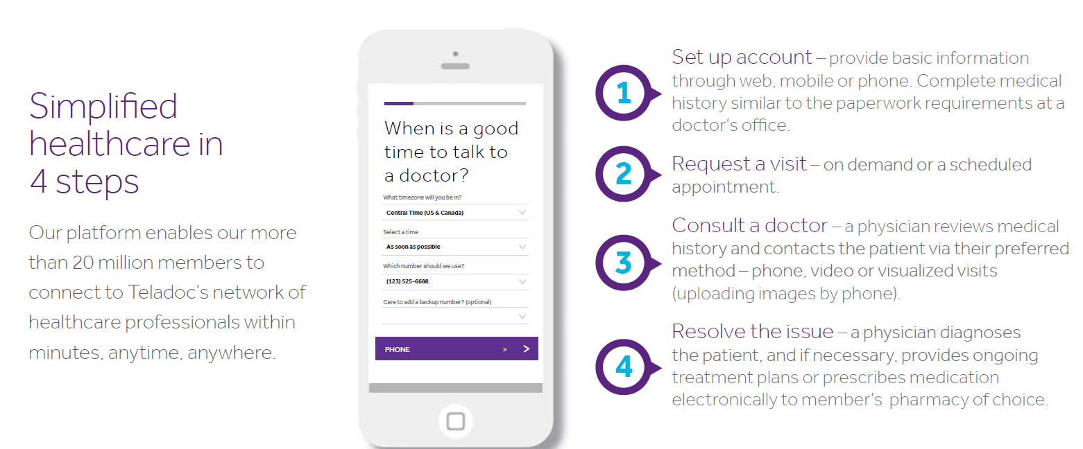

Slide 44

DENTAL INSURANCE
Benefit period 9/1/2023-8/31/2024

Slide 45
DENTAL INSURANCE
Members can register at www.ameritas.com and/or download the mobile app
There is a slight increase to your payroll contribution
Highest level of benefit is when using an in-network dentist
  Annual maximum $1500; per member on the plan (with carryover benefit)
  Individual deductible $50 applies to Basic/Major services
  Preventive: 100% in-network (2 cleanings/year)
  Basic services: 80% in-network
  Major services: 60% in-network
  Orthodontic: Lifetime maximum children $800

Slide 46
DENTAL INSURANCE
Carryover benefit: Refer to your certificate book or your account at Ameritas to see how much you have. By filing a claim each year, your can increase your Annual Maximum.
  Each benefit period: $250 may be carried forward
  PPO Bonus/benefit period: $150
  Benefit Threshold/covered person: $750 (total claims cannot exceed this amount)
  Maximum Carry Over Amount: $1,000
  TO SECURE YOUR COVERAGE FOR THE PERIOD OF 9/1/2023-8/31/2024 submit your forms by Noon on 8/25/23.

Slide 47
VISION INSURANCE
Benefit period 9/1/2023-8/31/2024

Slide 48
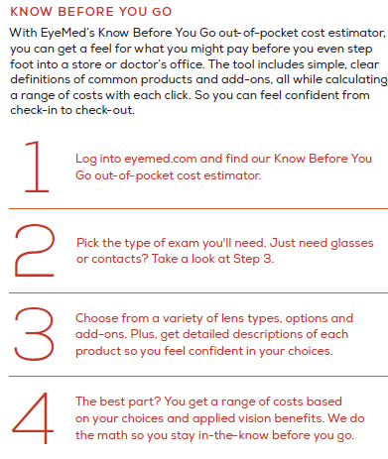


KNOW YOUR VISION BENEFITS BEFORE YOU GO!
  Register at www.eyemed.com

Slide 49

VISION INSURANCE
There is no change to your benefit or your payroll contribution
Highest level of benefit is achieved by using an in-network provider. If you are out-of-network, you will pay for services & then submit a claim for reimbursement.
  Annual exams every 12 months: $10 copay
  Retinal imaging: $39 copay (maximum limit)
  Lenses or Contact Lenses/12 months: various copays apply, see benefit summary
  Frames every 24 months: $130 allowance; 20% discount
  Additional discounts are available for 2nd pair of glasses, non-prescription sunglasses.

Slide 50

LIFE &
VOLUNTARY LIFE
INSURANCE
Benefit period 9/1/2023-8/31/2024
The Standard Insurance Company

Slide 51
BASIC LIFE / AD&D
The Employer paid benefit provides your beneficiary with proceeds from your policy when you pass away.
Refer to Human Resources for benefit information.
Update your beneficiary as needed.

Slide 52
VOLUNTARY LIFE / AD&D
We will host an open enrollment for this benefit in September. Watch your email for more information as we draw closer to the date.

Slide 53
ADDITIONAL BENEFITS THRU THE STANDARD

Slide 54
EMPLOYEE ASSISTANCE PROGRAM
(EAP)

Slide 55

EMPLOYEE ASSISTANCE PROGRAM (EAP)
This CONFIDENTIAL program is free & available to employees & their families of Proviso Township High School District 209.
Refer to your benefit book for more information.

Slide 56
TRAVEL
ASSISTANCE

Slide 57

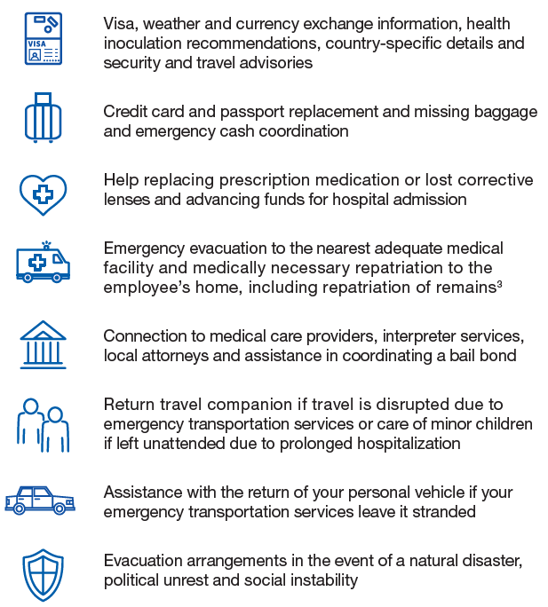
TRAVEL ASSISTANCE
When you travel more than 100 miles from home or internationally, assistance is available before & during your trip. Employees, their spouse & children through age 25 are covered.
Refer to your Benefit Book for more information.
Participation is confidential!

Slide 58
FAMILY BENEFITS for Higher Education

Slide 59
FAMILY BENEFITS for Higher Education
In the event of an Employee’s accidental death under the AD&D insurance benefit, your eligible dependent(s) may receive money towards a Career Adjustment, Child Care Benefit and/or Higher Education.
Be sure your beneficiary is aware of this benefit should you pass.
Refer to the Benefit Book for more information

Slide 60

EMPLOYEE RECAP
Review available benefit plans & dependents eligible to enroll.
All employees will need to submit their election form no later than Noon on Friday, 8/25/2023
Remember to complete the registration for Teladoc BEFORE you seek a consultation, if you haven’t already registered. Re-registration is not needed.
Update your beneficiary information as needed. Should you pass away, PTHS will direct the proceeds from your policy to the last known beneficiary on file.
Completed forms must be returned to Arlene Sabado on or before Noon on Friday, August 25, 2023

Slide 61


Thank you for your time.
Questions on enrollment, refer to Arlene Sabado.
General benefit questions to your Vista Team.

